Slide 1


Explore the Landscape of Generative AI
Dive into the rapidly evolving world of Generative AI and discover how this technology is reshaping industries and changing our lives.
by Jayesh Sharmila

Slide 2
What is Generative AI?
Definition
How it Works
Generative AI is a branch of artificial intelligence that focuses on creating new content like text, images, audio, video, and code.
Generative AI models learn patterns from massive datasets to generate similar but original content.

Slide 3
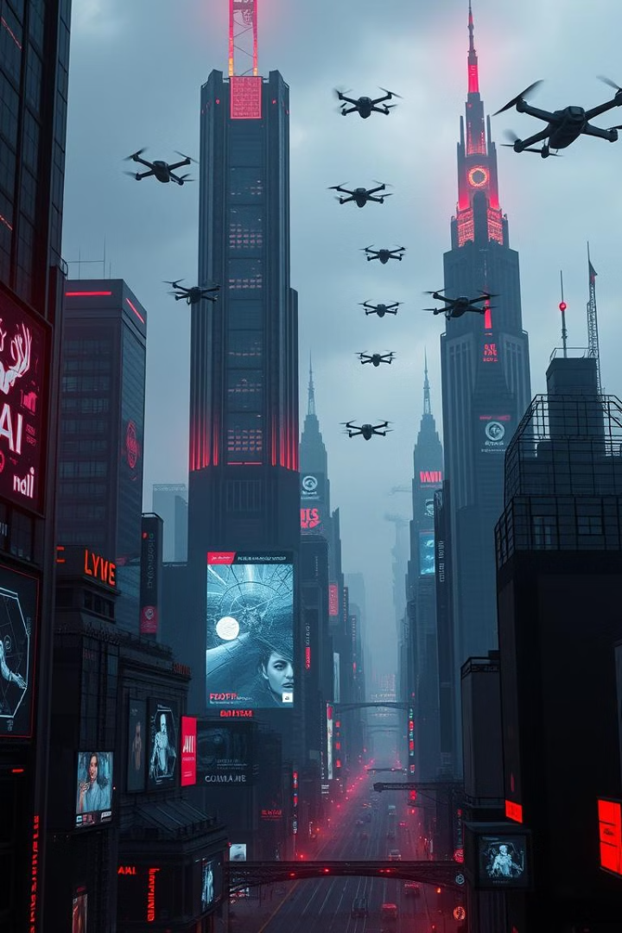



Current Trends and Applications
Rapid Adoption
Emerging Technologies
Generative AI is gaining traction across numerous industries, from creative arts to scientific research.
New tools and models are constantly evolving, pushing the boundaries of what AI can create.
Seamless Integration
Generative AI is being incorporated into existing applications and workflows, streamlining processes and enhancing capabilities.

Slide 4
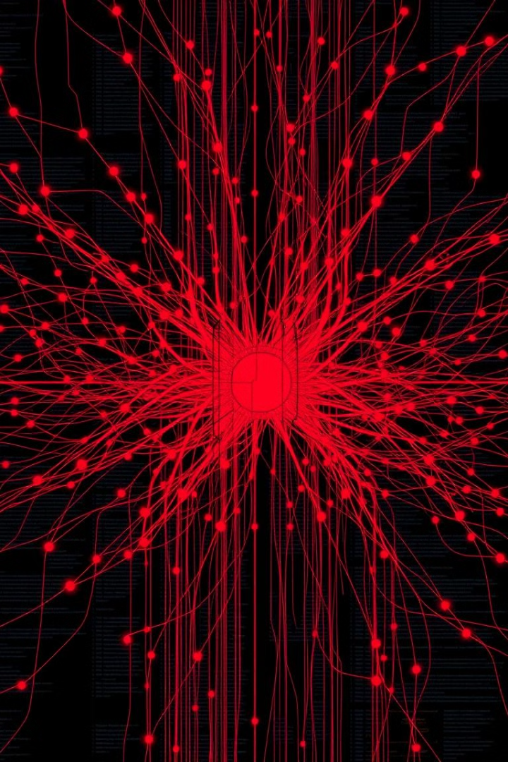
Large Language Models (LLMs) and their Capabilities
1
Natural Language Processing
2
Text Summarization
LLMs excel at understanding, interpreting, and generating human-like text.
LLMs can condense large amounts of text into concise summaries, saving time and effort.
3
Translation
4
Code Generation
LLMs facilitate communication by translating text between different languages with accuracy and fluency.
LLMs can assist developers by generating code snippets and even entire programs.

Slide 5
Text Generation: From Creative Writing to Chatbots
Creative Writing
Content Creation
Chatbots
Generative AI tools can assist writers by generating story ideas, characters, and dialogue.
AI-powered platforms are used to write articles, blog posts, and marketing materials.
Generative AI chatbots provide personalized customer service, automate responses, and streamline interactions.

Slide 6


Image Generation: Bringing Imagination to Life
Photorealistic Art
Abstract Art
AI can generate images that are indistinguishable from real-life photographs, pushing the boundaries of realism.
Generative AI models create abstract art pieces that capture imagination and evoke emotional responses.

Slide 7



Audio and Music Generation
Sound Design
1
AI can generate sound effects for games, movies, and other multimedia applications.
Music Composition
2
AI models can compose music in various genres, from classical to electronic.
Voice Generation
3
AI-powered tools can create realistic and expressive voices for audiobooks, video games, and virtual assistants.

Slide 8

Ethical Considerations and Challenges
Bias and Fairness
Privacy and Security
Generative AI models can inherit biases from the data they are trained on.
Protecting user data and ensuring the responsible use of AI is paramount.
Job Displacement
Misinformation and Deepfakes
Generative AI may automate tasks currently performed by humans, leading to potential job displacement.
The ability to create realistic content can be misused to spread misinformation and manipulate public perception.

Slide 9
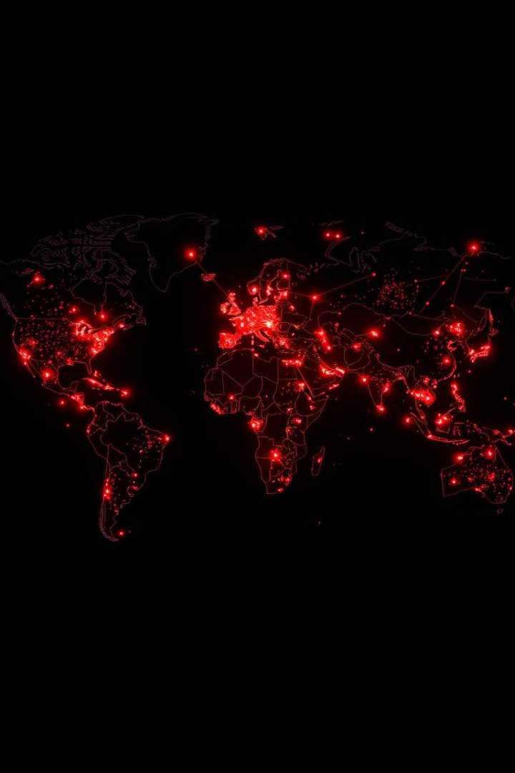
The Future of Generative AI: Advancements and Disruptions
1
Increased Realism
AI-generated content will become increasingly indistinguishable from human-created content.
2
Personalized Experiences
Generative AI will enable tailored content and experiences based on individual preferences.
3
New Creative Forms
AI will inspire new forms of art, entertainment, and communication, pushing the boundaries of human creativity.

Slide 10

Real-World Case Studies and Success Stories
10M
50%
90%
Increased Revenue
Improved Efficiency
Enhanced User Experience
AI-powered tools have helped companies increase revenue by automating tasks, personalizing customer experiences, and generating compelling marketing materials.
Generative AI has streamlined workflows, reduced errors, and freed up valuable time for human creativity.
Generative AI has created engaging and personalized experiences for users across industries.

